Slide 1
Transparent distributed caching over REST
Jan Paul Posma, Roan Kattouw and Roy Triesscheijn

Slide 2
Introduction
We’ve written a distributed cache with the following properties:
Cache nodes communicate via RMI to find the cache that has the information.
Values can be stored and requested using REST over HTTP

Slide 3
Why caching?
For Websites and web application it is important that pages are served quickly.
Information is stored in a database (all knowing but slow)
Look up from a cache is faster. Data is stored in memory in an efficient data structure (HashMap in our case)

Slide 4
Why distributed?
We can create a cache spanning multiple servers
Or multiple caches on one computer
We can easily add more computers to increase the memory size of our cache

Slide 5
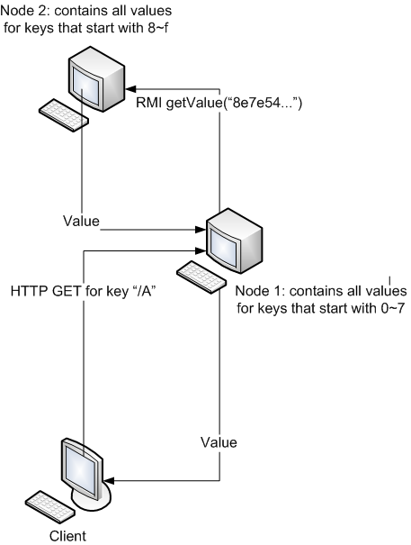
Design
Each node runs a basic HTTP server and is connected to other nodes using RMI
Client issues a HTTP GET request with a key variable to a random node (Node 1 in this case)
Node 1 hashes the key and finds out what node could have this information (we actually use a slightly different algorithm as pictured, using modulo)
Node 1 requests information from Node 2 using RMI
Node 1 sends “value” for given key back to the client
Roughly the same for POST-ing of values

Slide 6
HTTP GET requests
HTTP GET request format
When getting the value of a cache key the following HTTP request-response dialog takes place: (client, server)
GET /mykey HTTP/1.0
HTTP/1.0 200 OK
Date: Mon, 11 Apr, 2011 16:56:04 CEST
Content-Type: text/plain; charset=utf-8
Content-Length: 12
Connection: close
Hello World!

Slide 7
HTTP POST requests
HTTP POST request format
When setting the value of a cache key the following HTTP request-response dialog takes place: (client, server)
POST /mykey HTTP/1.0
Content-Length: 12
Hello World!
HTTP/1.0 200 OK
Date: Mon, 11 Apr, 2011 16:57:58 CEST
Content-Type: text/plain; charset=utf-8
Content-Length: 0
Connection: close

Slide 8
Local cache
All caches implement the interface ICache which require the classes to implement get, set and clear
HashMap stores key-value pairs of strings
LinkedList to throw away values when the cache is full

Slide 9
Remote cache
We use ICache as a remote interface
RemoteCache is the transparent handler for all caching requests, keeps a list of know servers and a local cache
A HashBalancer is used to determine where to store and look for key/value pairs
An RMI call is made when data is not stored at the local cache.

Slide 10
Real word examples
There are many real world examples:
  Memcached
  QuickCached
  SwarmCache

